Slide 1
The Modern Software Developer
CS146S
Stanford University, Fall 2025
Mihail Eric
themodernsoftware.dev

Slide 2
Automated UI and App Building
themodernsoftware.dev

Slide 3
This is not the “vibe coding” class
themodernsoftware.dev
Notes:
Because I’m a software development purist

Slide 4
…except today
themodernsoftware.dev

Slide 5
Why
Modern SaaS development has focused on web apps for over two decades
themodernsoftware.dev
Notes:
Salesforce in 1999 often considered first SaaS platform

Slide 6
The Old Days
LAMP
MERN
JAM
Serverless
themodernsoftware.dev
Notes:
LAMP Stack
Technologies: Linux (OS), Apache (Web Server), MySQL (Database), PHP (Backend)
Description: Classic open-source web stack for dynamic websites and traditional web apps.
MERN Stack
Technologies: MongoDB, Express.js, React.js, Node.js
Description: Full JavaScript stack for building modern, interactive single-page web apps (SPAs).
MEVN Stack
Technologies: MongoDB, Express.js, Vue.js, Node.js
Description: JavaScript-based stack using Vue instead of React — lightweight, flexible, and easy to learn.
Serverless Stack
Technologies: Frontend (React/Vue/Svelte), Backend (AWS Lambda, Google Cloud Functions), Database (DynamoDB, Firebase)
Description: Cloud-native stack — runs backend logic on-demand without managing servers; ideal for scalable, event-driven apps.

Slide 7




The Old Days
client-side
server-side
database
themodernsoftware.dev
Notes:
MERN

Slide 8
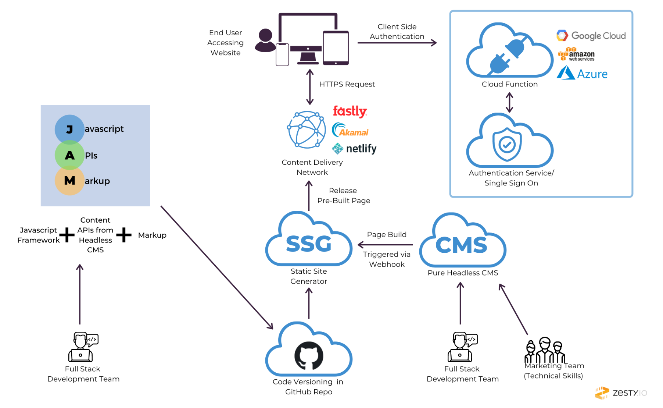
The Old Days
themodernsoftware.dev
Notes:
JAM
Components:
JavaScript – for dynamic functionalities
APIs – to connect backend services
Markup – prebuilt static HTML
Usage: Used for static sites and modern web apps. Common tools include Gatsby, Next.js, or Nuxt.js with headless CMSs like Contentful or Sanity.

Slide 9
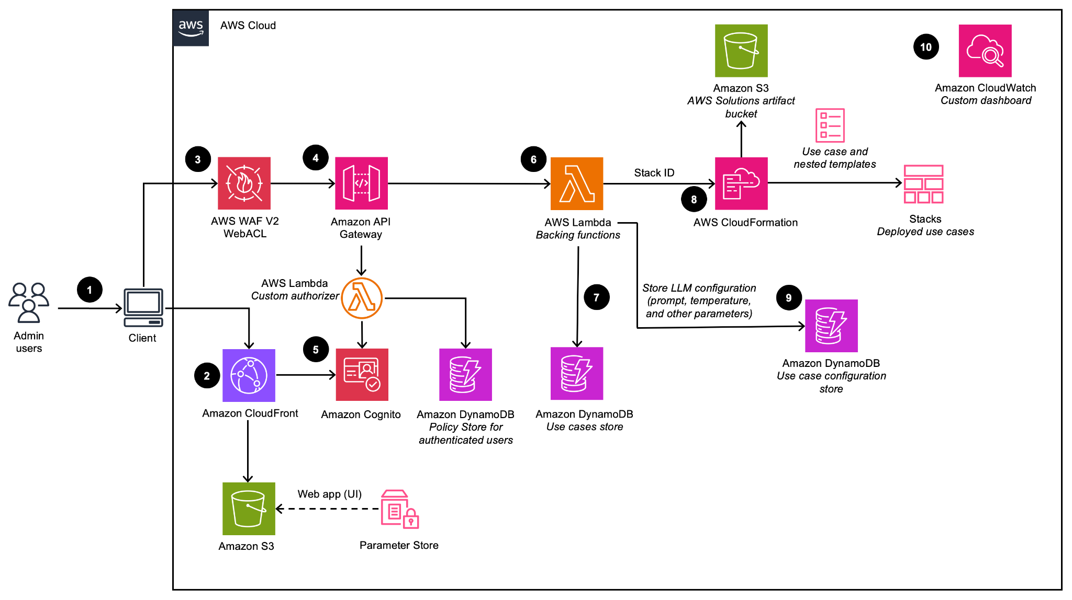
The Old Days
themodernsoftware.dev
Notes:
AWS Stack

Slide 10
Take #1: Visual Low-code/No-code
Wix
Squarespace
Webflow
themodernsoftware.dev

Slide 11
The New AI World
Lovable
Replit
Vercel v0
Base44
Cursor/Claude Code/etc
themodernsoftware.dev

Slide 12
What Has Changed
Prompt your way to a fully fledged app
Engineers are becoming more cross-functional
Design
Product management
Anyone can build an app now
More user-friendly than 1st generation no-code platforms like Webflow, Wix, Squarespace
themodernsoftware.dev

Slide 13
Let’s Make An App Right Now
themodernsoftware.dev
Notes:
Bolt example with FE/BE
Make salsa partner finder
Additional changes after initial generation
Update color palette
Iconography
Typography
—-
This looks good. I want to update the color pallette to follow the following colors:
#EF8354
#660000
#EFCA08

Slide 14
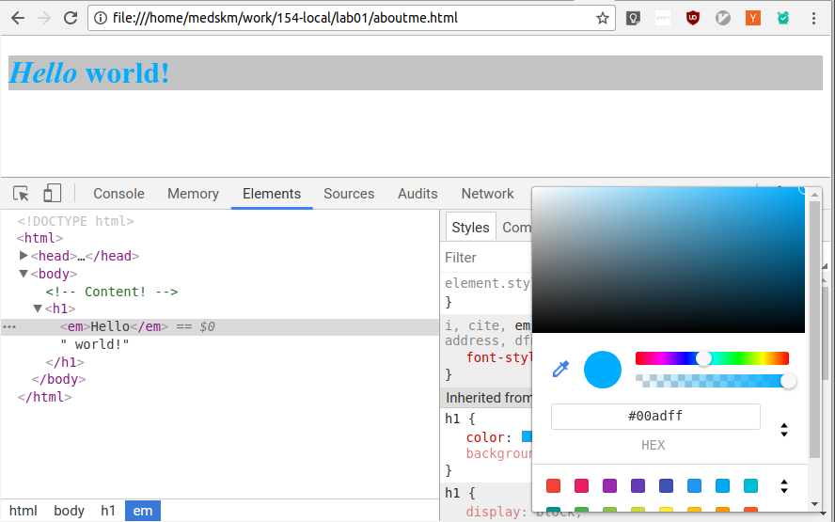
App Builder Architecture
WebContainer
themodernsoftware.dev
Notes:
Webcontainer running arbitrary generated code

Slide 15
App Builder System Prompt
themodernsoftware.dev
Notes:
Explicitly requests only established, well-known technologies/frameworks
https://gist.github.com/curran/753aa62fd99b7df8f858743d605f1d02
https://app.prompthub.us/prompthub/bolt-agent-system-prompt
boltartifact/Boltaction to designate things that should happen (file creation, file running, etc) in the webcontainer

Slide 16
Limitations
Everything is awesome when it works but once things break we’re back at square 1
Prompts are just suggestions. Not every user understands that
Security has been an issue in the past
How do we prevent all these apps from looking the same?
How complex can these apps realistically get?
themodernsoftware.dev

Slide 17
Questions?
themodernsoftware.dev

